Slide 1
What is new in PowerShell 7

Slide 2
Agenda
Login Shell
ErrorView / Get-Error
.net Core 3.1 (New API’s)
New operators:
Ternary
Chain
Null Conditional for coalescing and assignment
Null Conditional Member Property and Method Access

Slide 3
Agenda
A bunch of nice things!
ActionPreference Break
Invoke-RestMethod
JSON stuff
ForEach-Object Parallel
xPlat DSC Compilation without OMI / DSC

Slide 4
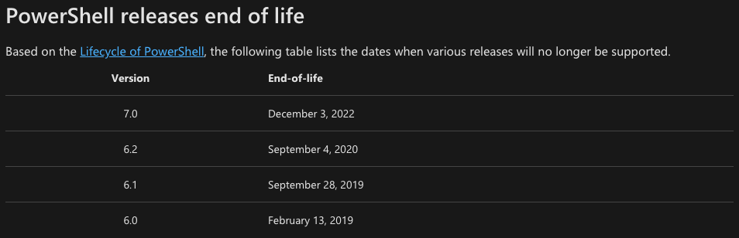
https://docs.microsoft.com/en-us/powershell/scripting/powershell-support-lifecycle?view=powershell-7#powershell-releases-end-of-life

Slide 5
Demo time!

Slide 6

About me:
bgelens.nl
@bgelens
@bgelens

